Slide 1
Software Re-Engineering
Lecture No.04
BSSE – 7 & 8
Instructor: Muhammad Usman Shahid

Slide 2
Lecture 4: Content
Evolution Of Software Systems
SPE Taxonomy

Slide 3
Evolution Of Software Systems
Dynamic growth of software
Maintenance means preserving software from decline or failure.
Evolution means a continuously changing software from a worse state to a better state

Slide 4
SPE Taxonomy
SPE refers to
S (Specified),
P (Problem),
and E (Evolving) programs.

Slide 5
S-type programs:
S-type programs have the following characteristics:
All the nonfunctional and functional program properties that are important to its stakeholders are formally and completely defined.
Correctness of the program with respect to its formal specification.
And it is the only criterion of the acceptability of the solution to its stakeholders.

Slide 6
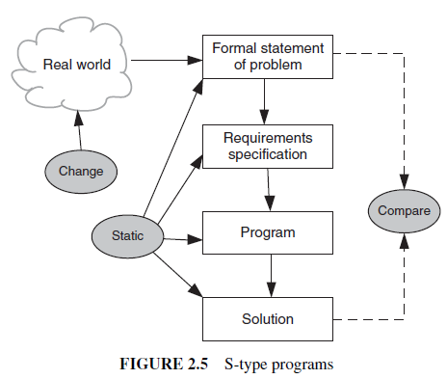
S-type programs:

Slide 7
P-type programs
The concept of correctness is difficult to define in these programs.
Therefore, approximate solutions are developed for logical reasons.

Slide 8
P-type programs
Numerical problems, except computations with integers and rational numbers, are resolved through approximations.

Slide 9
P-type programs
For example, consider a program to play chess.
Since the rules of chess are completely defined, the problem can be completely specified.
At each step of the game, a solution might involve calculating the various moves and their impacts to determine the next best move.

Slide 10
P-type programs
However, complete implementation of such a solution may not be possible, because the number of moves is too large to be evaluated in a given time duration.
Therefore, one must develop an approximate solution that is more practical while being acceptable.

Slide 11
P-type programs
In order to develop this type of solution, we describe the problem in an abstract way and write the requirement specification accordingly.
A program developed this way is of P-type
because it is based on a practical abstraction of the problem, instead of relying on a completely defined specification.

Slide 12
P-type programs
Even though an exact solution may exist, the solution produced by a P-type program is tampered by the environment
in which it must be produced.
The solution of a P-type program is accepted if the program outcomes make sense to the stakeholder(s) in the world in which the problem is embedded.

Slide 13
P-type programs
As illustrated in Figure 2.6 (Next slide), P-type programs are more dynamic than S-type programs.
P-type programs are likely to change in an incremental fashion.
If the output of the solution is unacceptable, then the problem abstraction may be changed, and the requirements modified to make the new solution more realistic.

Slide 14
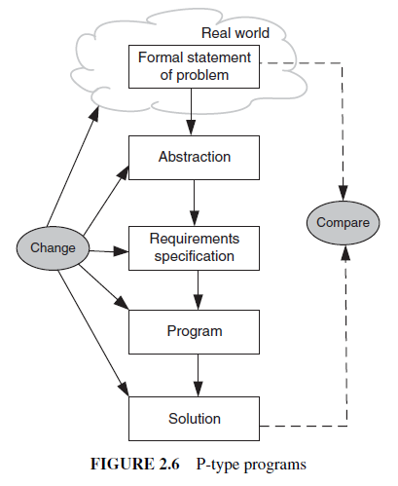
P-type programs

Slide 15
P-type programs
Note that the program resulting from the changes cannot be considered a new solution to a new problem.
Rather, it is a modification of the old solution to better fit the existing problem.
In addition, the real world may change, hence the problem changes.

